Slide 1



University Institute of Engineering
DEPARTMENT OF COMPUTER SCIENCE & ENGINEERING
Subject Name: Software Engineering
Subject Code: 23CST-206
Er. Jagmeet Kaur
E8387
ASSISTANT PROFESSOR
CSE
DISCOVER . LEARN . EMPOWER

Slide 2
Topics covered
Object Oriented Design

Slide 3
Object Oriented Design
In the object-oriented design method, the system is viewed as a collection of objects (i.e., entities).
The state is distributed among the objects, and each object handles its state data.
For example, in a Library Automation Software, each library representative may be a separate object with its data and functions to operate on these data.

Slide 4
Object Oriented Design
The tasks defined for one purpose cannot refer or change data of other objects.
Objects have their internal data which represent their state. Similar objects create a class.
In other words, each object is a member of some class. Classes may inherit features from the super class.

Slide 5
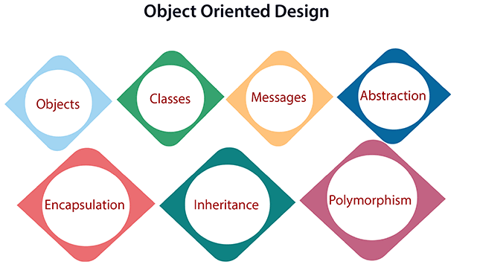
Object Oriented Design

Slide 6
Object Oriented Design
Objects: All entities involved in the solution design are known as objects.
For example, person, banks, company, and users are considered as objects.
Every entity has some attributes associated with it and has some methods to perform on the attributes.

Slide 7
Object Oriented Design
Classes:
A class is a generalized description of an object. An object is an instance of a class.
A class defines all the attributes, which an object can have and methods, which represents the functionality of the object.

Slide 8
Object Oriented Design
Messages:
Objects communicate by message passing.
Messages consist of the integrity of the target object, the name of the requested operation, and any other action needed to perform the function.
Messages are often implemented as procedure or function calls.

Slide 9
Object Oriented Design
Abstraction In object-oriented design, complexity is handled using abstraction.
Abstraction is the removal of the irrelevant and the amplification of the essentials.
Encapsulation: Encapsulation is also called an information hiding concept.
The data and operations are linked to a single unit. Encapsulation not only bundles essential information of an object together but also restricts access to the data and methods from the outside world.

Slide 10
Object Oriented Design
Inheritance:
OOD allows similar classes to stack up in a hierarchical manner where the lower or sub-classes can import, implement, and re-use allowed variables and functions from their immediate super classes.
This property of OOD is called an inheritance.
This makes it easier to define a specific class and to create generalized classes from specific ones.

Slide 11
Object Oriented Design
Polymorphism:
OOD languages provide a mechanism where methods performing similar tasks but vary in arguments, can be assigned the same name.
This is known as polymorphism, which allows a single interface is performing functions for different types.
Depending upon how the service is invoked, the respective portion of the code gets executed.

Slide 12
Advanatges
The OO model is beneficial in the following ways −
It facilitates changes in the system at low cost.
It promotes the reuse of components.
It simplifies the problem of integrating components to configure large system.
It simplifies the design of distributed systems.

Slide 13
Stages of Object Oriented Design
The stages for object–oriented design can be identified as −
Definition of the context of the system
Designing system architecture
Identification of the objects in the system
Construction of design models
Specification of object interfaces

Slide 14
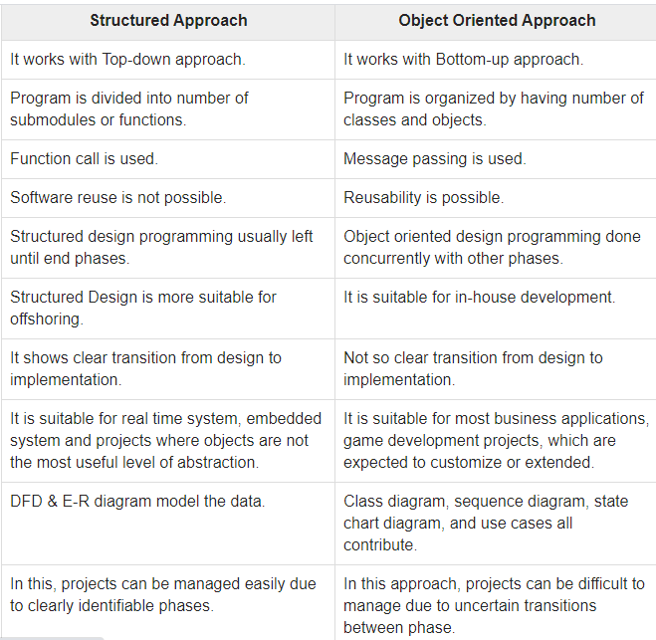

Slide 15
REFERENCES
Reference Books:
Suman Ugrasen, “Software Engineering - Concepts and Practices”, First Edition, Cengage.
Mohammad Ali Shaikh, “Software Engineering with UML”, Third Edition, Notion Press.
Somerville Ian, “Software Engineering”, Addison Wesley, 8th Edition.
Text Books:
Pressman Rogers, “Software Engineering: A Practitioner's Approach”, Sixth edition. Patterson and Hennessy, “Computer Architecture” , Fifth Edition Morgaon Kauffman.
Rajib Mall, “Fundamentals of Software Engineering’’, Fourth Edition, Pearson, PHI.

Slide 16
THANK YOU

